Slide 1

Estructura de Datos ||
Jonathan López Londoño
jlopezl@uao.edu.co
315 926 5443

Slide 2
Queues
Most common example about queues in programming is:
Imagine that we have a line of people to enter a specific restaurant.
The last person to get in the line will be the last person to enter the restaurant, depending on the size of the line.
The first person that got into line will be the first person to enter the restaurant.

Slide 3
Queues
A structure of sequential and ordered elements.
Is based on the principle of last in first out (FIFO). Always the first element that we add, will be the first that we take out

Slide 4
Using Queues
The most common uses of queues today are present in tools and processes that we see every day: task or job queues, such as messaging queues.
In these cases, it is necessary that the first data to enter is the first to leave and is ordered chronologically and in order of arrival.

Slide 5
Queues Methods
A Queue must have methods that allow adding new elements, removing them and reviewing them (one or more).
We can make our own implementation and call these methods in any way.
There is an agreed convention of using the following definitions:
enqueue: Adds a new element to the queue, placing it at the end of it.
dequeue: Returns the first element of the queue, removing it from the queue.
peek: Returns the first element of the queue, without removing it from the queue.
size: Returns the number of elements in the queue.
isEmpty: Returns true if the queue is empty.
print: Prints the contents of the queue.

Slide 6
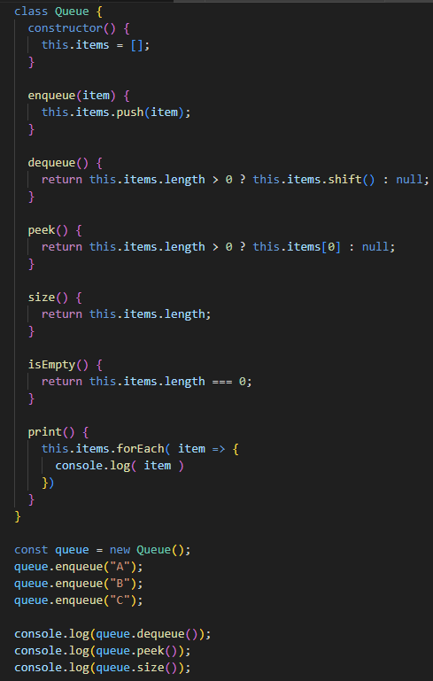
How to implement Queues?
Peek is the only one method we need to implement, the others come from Prototype in JavaScript

Slide 7
CHALLENGE 09
Create and handle new queue of people in one ATM. Every person in the ATM must have its name and withdrawal amount.
Fill the queue with some mock data
Create a new project in react, and implements a new screen with a form to create a new person, then add the person to the queue
Print the queue in screen

